Slide 1
CSSE 490 Deep Reinforcement Learning
AlphaGo
Image/Text partially captured from https://jonathan-hui.medium.com/alphago-how-it-works-technically-26ddcc085319

Slide 2
AlphaGo Overview
Supervised Training
RL Training
MCTS

Slide 3
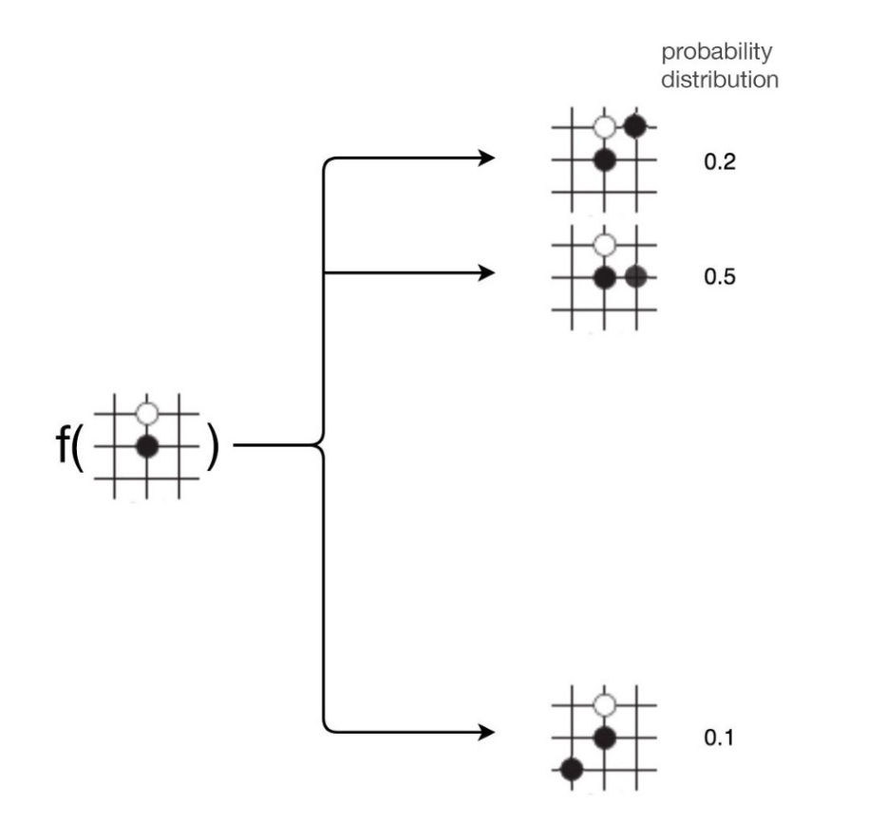
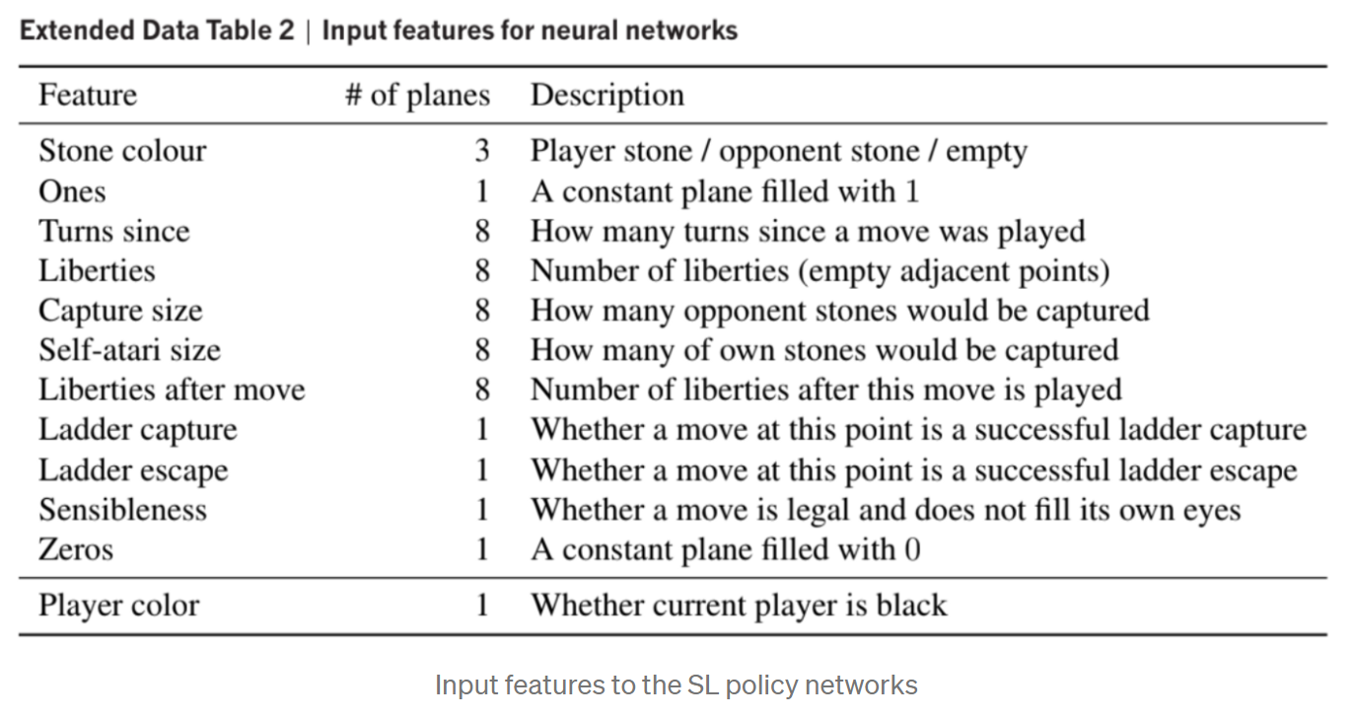
Supervised Training
Input 19x19x48
Output the probabilities of all possible moves

Slide 4
SL Training
To train the SL policy network, AlphaGo collects moves for 30 million board positions.
AlphaGo uses 50 GPUs to train the network and it takes 3 weeks. The SL policy network achieves a 57% accuracy. It sounds not too accurate but this policy network can beat an advanced amateur already.

Slide 5
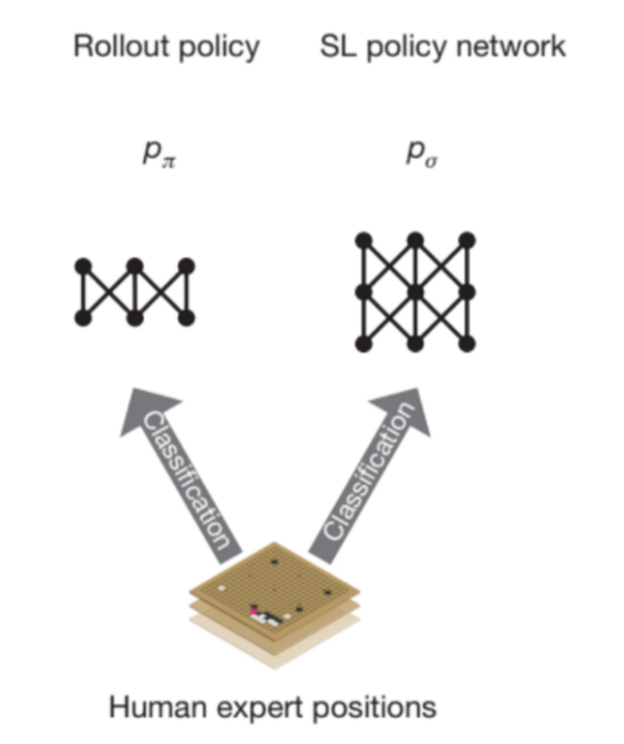
Rollout Network
We create another policy called rollout policy π which use a more simple linear softmax classifier. It takes 2 μs to compute each move instead of the 3 ms in the SL policy network. This rollout policy has a lower 24.2% accuracy (compared to 55.7%) but it is 1500x faster.

Slide 6
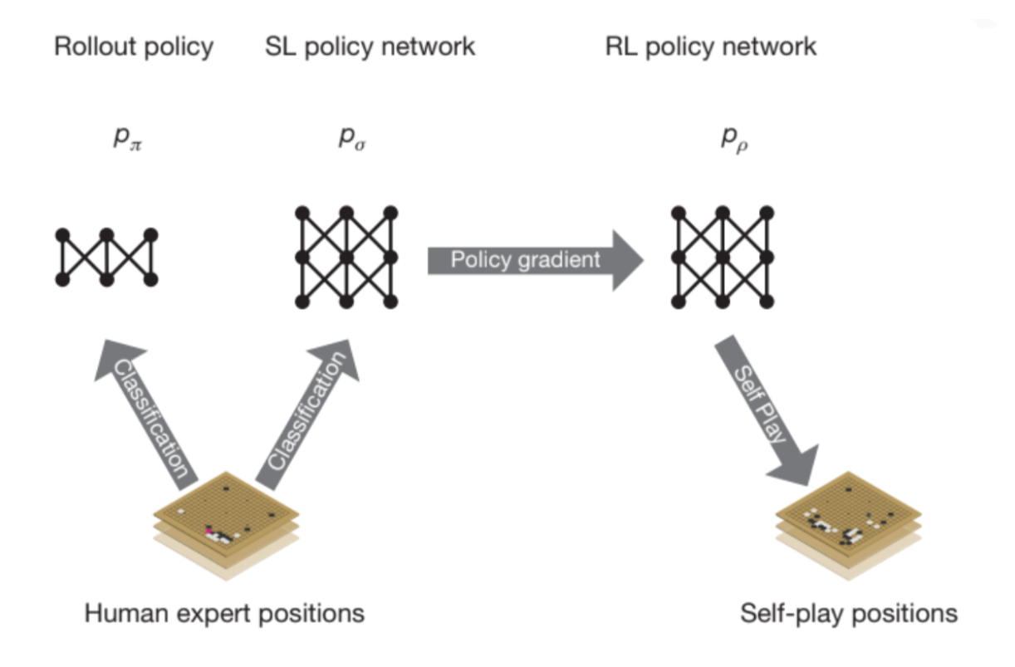
Reinforcement learning (RL) of policy networks
First, we duplicate SL policy network and call it RL policy network ρ.

Slide 7
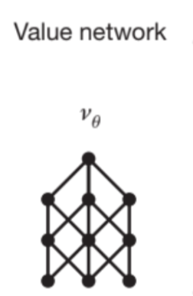
Train RL networks and V networks
We start playing games using the new RL policy network. For our opponent, we randomly reuse one of the older RL policy networks. We don’t play each other with the same policy network because it will overfit the current policy. (i.e. it will memorize the moves rather than generalize it for different opponents.)
After training, we get

Slide 8
Another look at RL networks

Slide 9
Monte Carlo Tree Search (MCTS)
This is used when actually playing games
Four stages:
Selection
Expansion
Evaluation
Backup

Slide 10
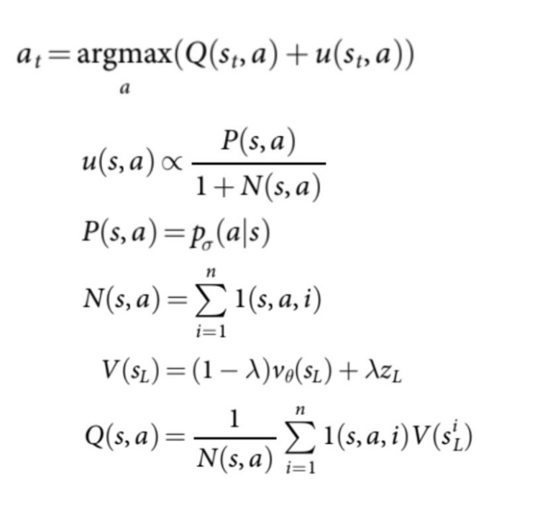
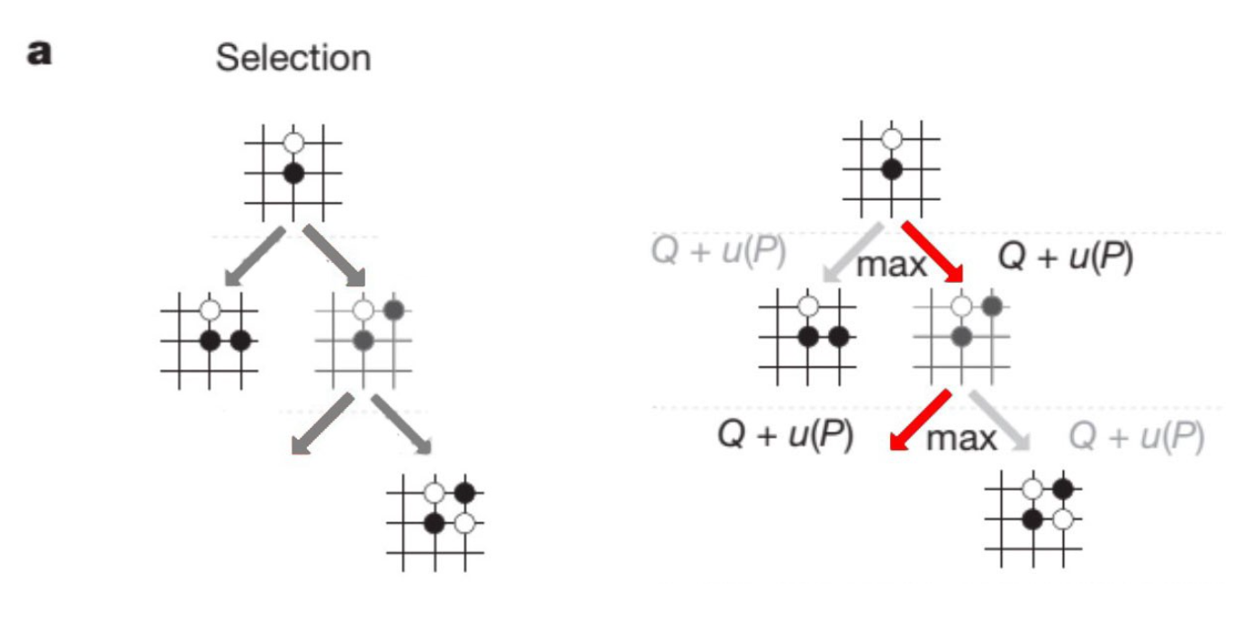
MCTS - selection

Slide 11
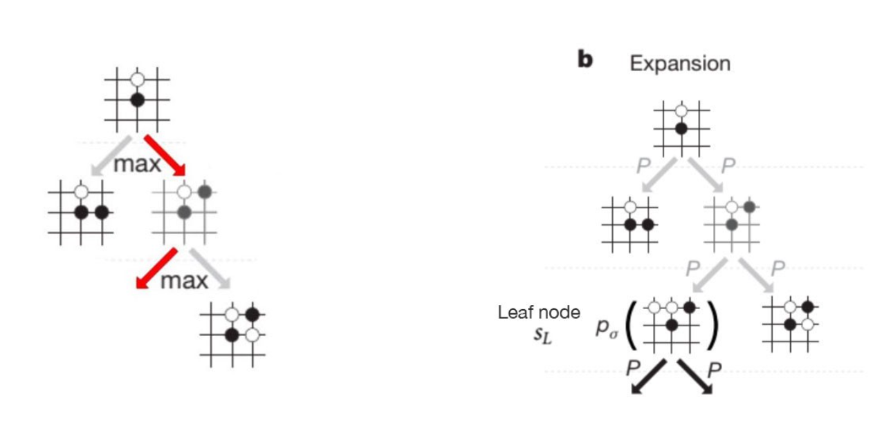
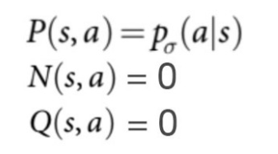
MCTS - expansion
we add more positions into the tree reflecting what moves (edges) we have tried.

Slide 12
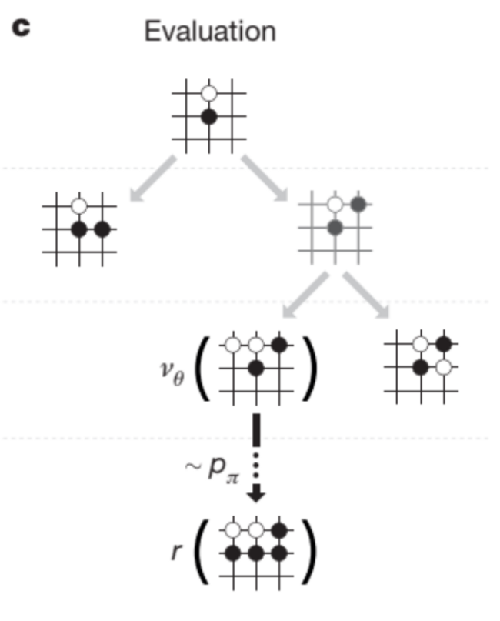
MCTS - evaluation
In this case, we use the rollout policy instead of the SL policy or the RL policy. Even it is lower in accuracy but it is 1500x faster. We need the speed to simulate many rollouts. To play the rest of the game, we sample moves using the rollout policy.

Slide 13
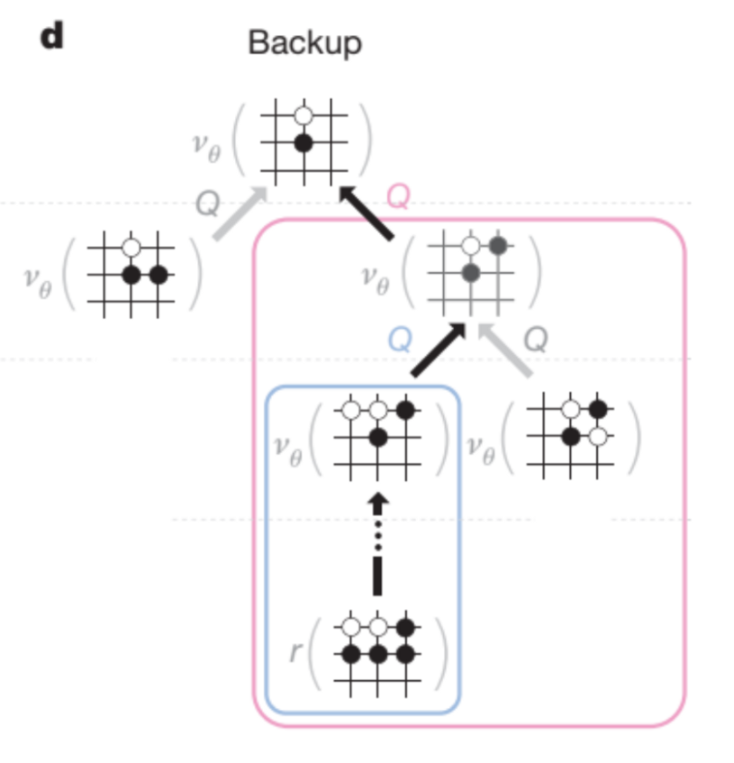
MCTS – back up

Slide 14
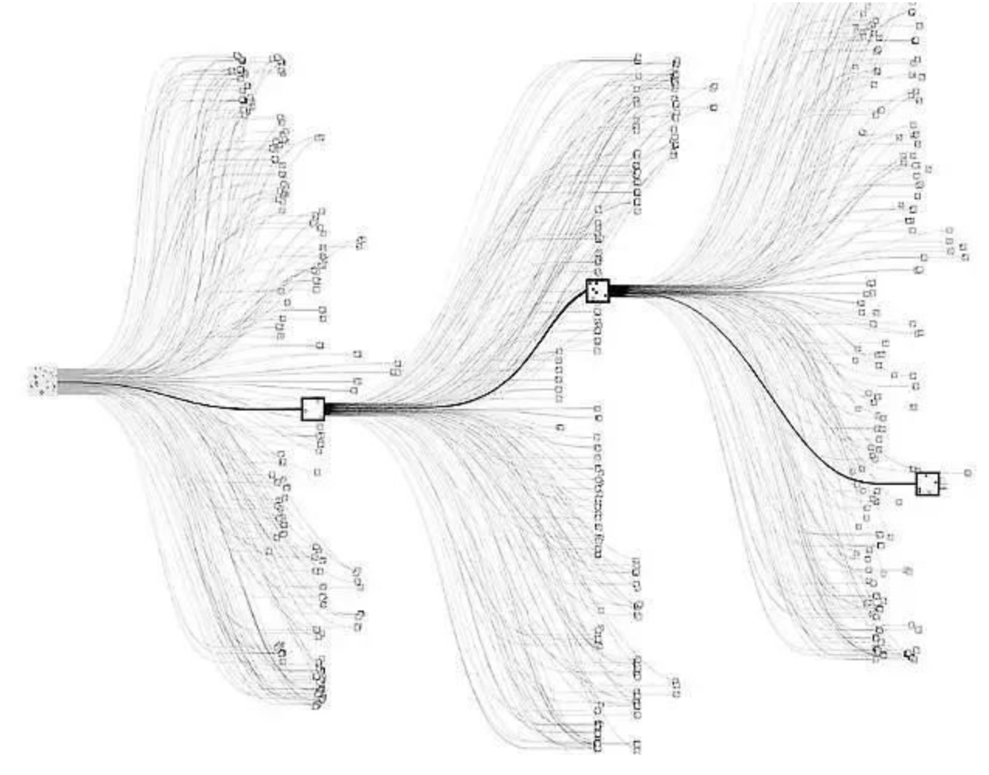
How many MCTS?
To make a move in Alpha-Go Zero, 1,600 searches will be computed.

Slide 15
MCTS is the soul of AlphaGo/Zero
MCTS in continuous action spaces?
Continuous Upper Confidence Trees
A0C: Alpha Zero in Continuous Action Space

