Slide 1
CSSE 490 Deep Reinforcement Learning
Model-Based RL I
Slides are heavily adapted the slides from IERG 5350 and Berkeley Deep RL Bootcamp and cs285@Berkeley

Slide 2
Outline
Intro to model-based RL
LQR demo

Slide 3
What is model?
Usually a model M = (P, R) represents state transitions and rewards
Given the model, the problem of RL becomes a planning problem.

Slide 4
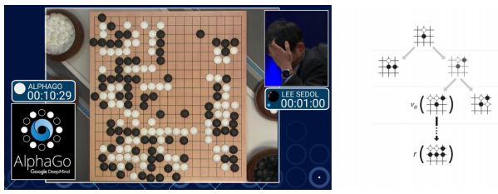
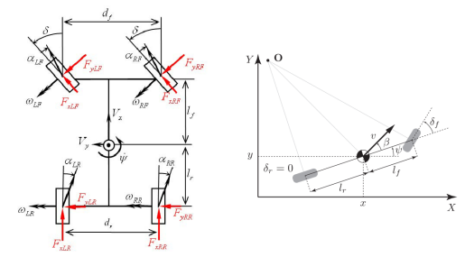
Sometimes it is easy to access the model
Known models: Game of Go: the rule of the game is the model
Physics models: Vehicle dynamics model and kinematics bicycle model

Slide 5
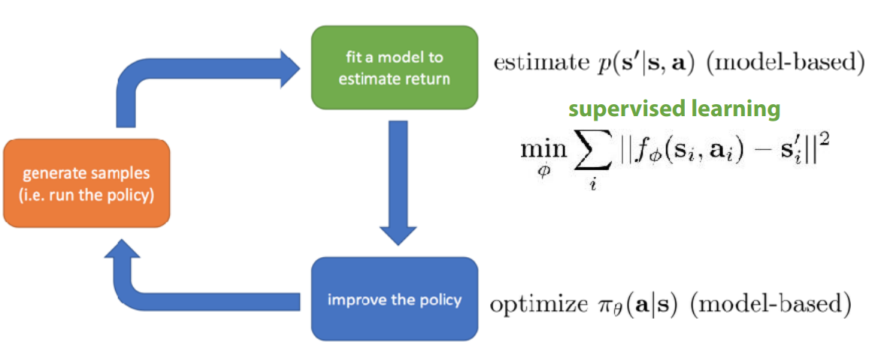
Modeling the Environment for Planning
Planning is the computational process that takes a model as input and produces or improves a policy by interacting with the modeled environment

Slide 6
Advantages of Model-based RL
Better sample efficiency

Slide 7
What to do with the model
Optimal control
Linear model -> LQR (demo later), Qudratic programming
Nonlinear: iLQR, and etc
Model Prediction Control
Random shoting
CEM

Slide 8
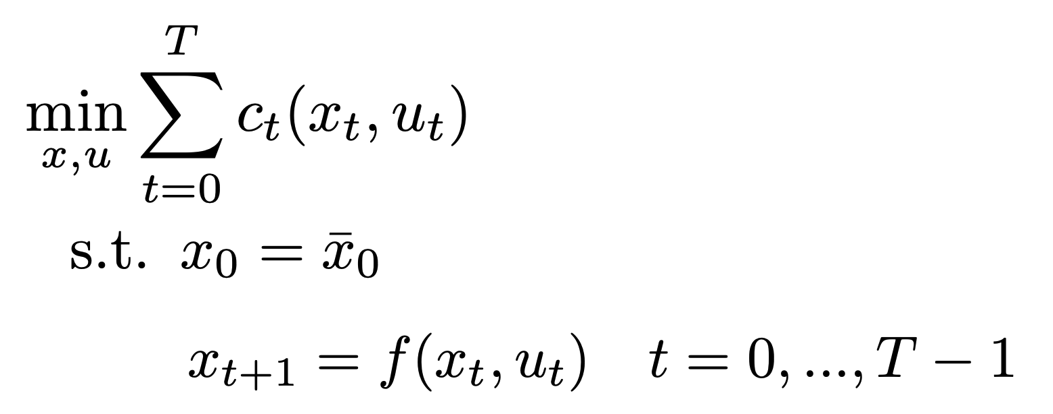
Example: LQR
Goal of optimal control

Slide 9
q

Slide 10
Typical challenges of Model-based RL
Model bias

Slide 11
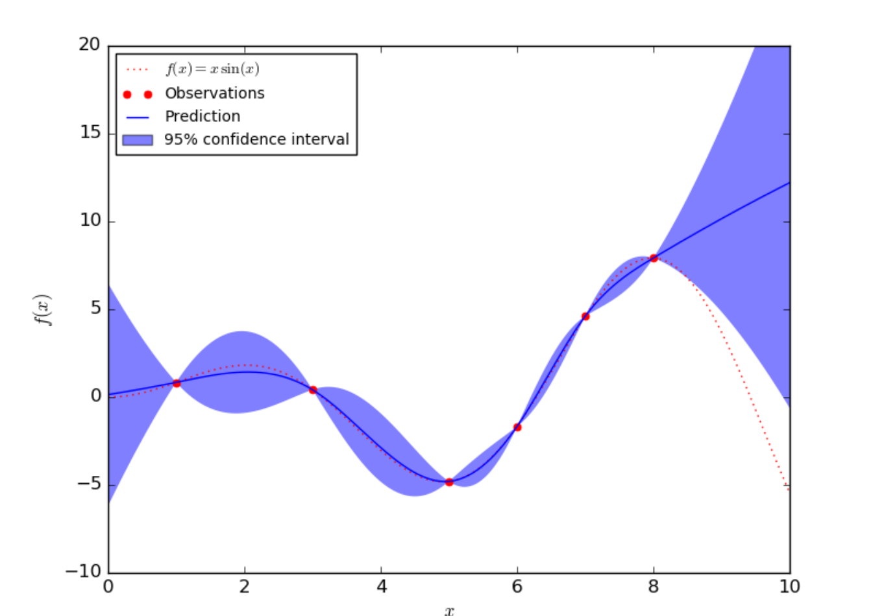
A good solution
Incorporate model uncertainty

Slide 12
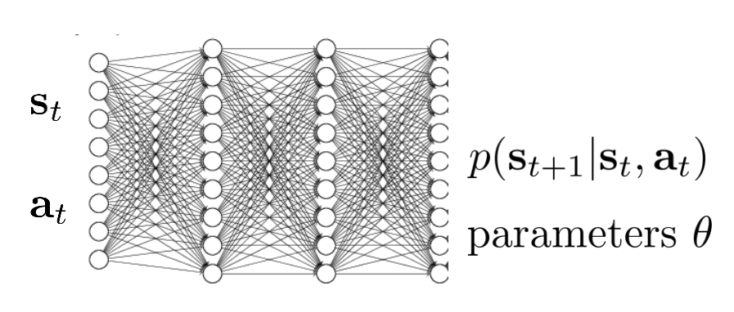
Deep Reinforcement Learning in a Handful of Trials using Probabilistic Dynamics Models

Slide 13
Bootstrap ensembles

