Slide 1
CSSE 490 Deep Reinforcement Learning
Actor Critic
Slides are heavily adapted from IERG 5350 from CUHK

Slide 2
Outline
Intro to Actor Critic
A2C

Slide 3
Value-Based and Policy-Based RL

Slide 4
Reducing Variance Using a Critic
Monte-Carlo policy gradient still has high variance
We use a critic to estimate the action-value function,
Actor-critic algorithms maintain two sets of parameters
Critic Updates action-value function parameters w
Actor Updates policy parameters θ, in direction suggested by critic
Actor-critic algorithms follow an approximate policy gradient
Can we use V(s) instead of Q(s,a)?

Slide 5
Estimating the Action-Value Function
The critic is solving a familiar problem: policy evaluation
How good is policy πθ for current parameters θ?
To solve this, we can use
Monte-Carlo policy evaluation
Temporal-Difference learning

Slide 6
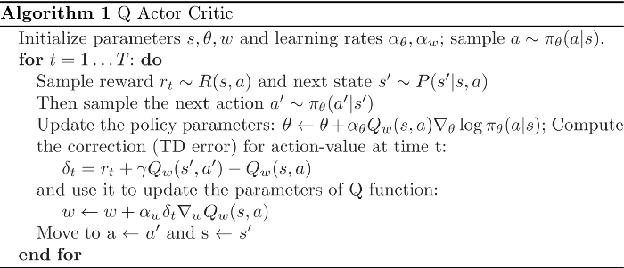
Action-Value Actor-Critic
Simple actor-critic algorithm based on action-value critic

Slide 7
Reducing Variance Using a Baseline
We subtract a baseline function B(s) from the policy gradient

Slide 8
Reducing Variance Using a Baseline
A good baseline is the state value function B(s) = V πθ (s)
So we can rewrite the policy gradient using the advantage function A πθ (s, a)

Slide 9
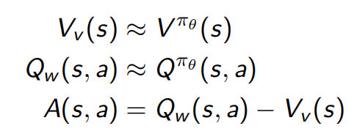
Estimating the Advantage Function (1)
The advantage function can significantly reduce variance of policy gradient
So the critic should really estimate the advantage function:
how better or worse the chosen action is compared to the current policy
Using two function approximators and two sets of parameters

Slide 10
Estimating the Advantage Function (2)
For the true value function V_{π}θ (s), the TD error

Slide 11
N-step estimators
Consider the following n-step returns for n = 1, 2, ∞
Then the advantage estimators become

Slide 12
Next
Enhance A2C to
improve exploration
reduce bias of the estimated advantage

