Slide 1
CSSE 490 Deep Reinforcement Learning
Policy Gradient
Slides are heavily adapted from IERG 5350 from CUHK

Slide 2
Outline
Policy-based reinforcement learning
Monte-Carlo policy gradient (REINFORCE)

Slide 3
Value-based RL versus Policy-based RL
Deterministic policy is generated directly from the value function using greedy a_{t} = arg max_{a} Q(a,s_{t})
Instead we can parameterize the policy function as πθ(a|s) where θ is the learnable policy parameter and the output is a probability over the action set

Slide 4
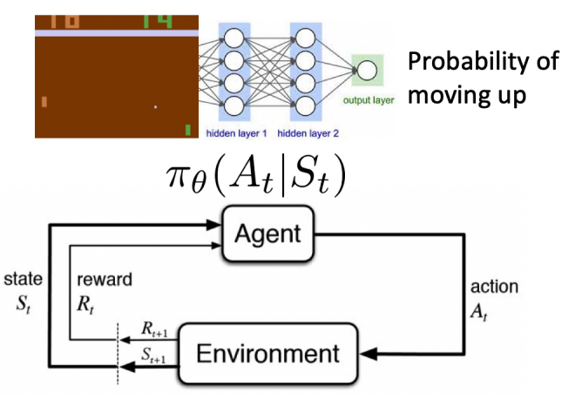
Policy Optimization
Action from the policy is all we need then let’s optimize the policy directly

Slide 5
Advantages of Policy-based RL
Advantages:
better convergence properties: we are guaranteed to converge on a local optimum (worst case) or global optimum (best case)
Policy gradient is more effective in high-dimensional action space
Policy gradient can learn stochastic policies, while value function can’t
Disadvantages:
typically converges to a local optimum
evaluating a policy has high variance

Slide 6
Two Types of Policies
Deterministic: given a state, the policy returns a certain action to take
Stochastic: given a state, the policy returns a probability distribution of the actions (e.g., 40% chance to turn left, 60% chance to turn right) or a certain Gaussian distribution for continuous action

Slide 7
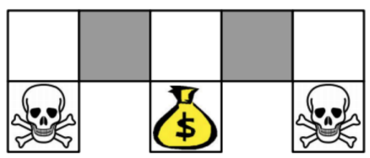
Why stochastic policy is better?
Example: Aliased Gridworld
The observation is the objects around a cell.
The agent cannot differentiate the two grey states as they look the same to the agent

Slide 8
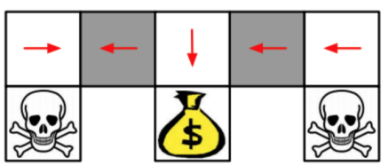
Example: Aliased Gridworld
Value-based RL learns a deterministic policy, e.g., greedy
Either way, 50% chance will get stuck

Slide 9
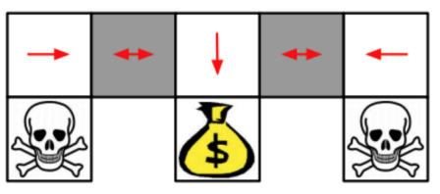
Example: Aliased Gridworld
Policy-based RL can learn the optimal stochastic policy
For any starting point, it will reach the goal state in a few steps with high probability

Slide 10
Objective of Optimizing Policy
Objective: Given a policy approximator πθ(s, a) with parameter θ, find the best θ
For example,
If J(θ) is differentiable, we can use gradient-based methods. If not, we can use CEM.

Slide 11
Policy Gradient Theorem
Proof HERE
Notes:
No pi(a|a) no expectation.

Slide 12
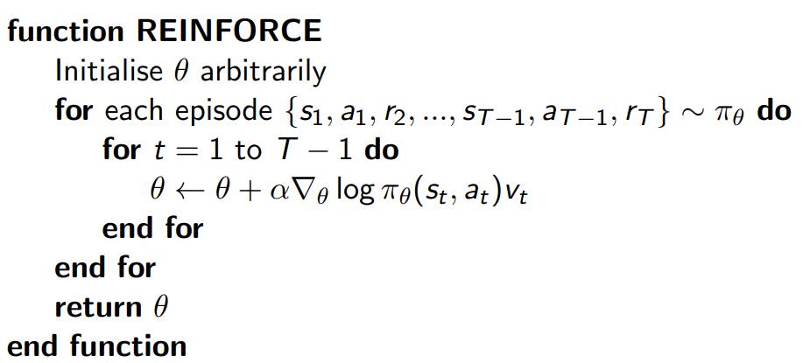
Monte-Carlo Policy Gradient (REINFORCE)
$$G_{t}$$

Slide 13
Next
How to reduce the variance of G_{t}

