Slide 1
CSSE 490
Deep Reinforcement Learning
Introduction to Deep Learning (continue)
Heavily adapt from Deep Learning Tutorial from Hung-yi Lee

Slide 2
Outline
Universal Theorem
Why Deep
Overfit
  Dropout
  Weight decay
Mini-Batch
Gradient Vanish
Activation functions
Learning Rate
CNN/RNN

Slide 3

Deeper is Better?
Layer X Size | Word Error Rate (%)
1 X 2k | 24.2
2 X 2k | 20.4
3 X 2k | 18.4
4 X 2k | 17.8
5 X 2k | 17.2
7 X 2k | 17.1
Layer X Size ^{Word Error}
Rate (%)
1 X 3772 22.5
1 X 4634 22.6
1 X 16k 22.1
Not surprised, more parameters, better performance
Seide, Frank, Gang Li, and Dong Yu. "Conversational Speech Transcription Using Context-Dependent Deep Neural Networks." Interspeech. 2011.

Slide 4
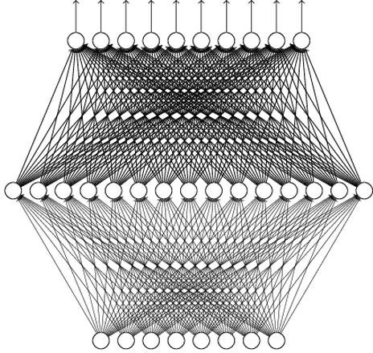
Universality Theorem
Any continuous function f
f : R ^{N} → R^{M}
Can be realized by a network with one hidden layer
(given enough hidden neurons)
Reference for the reason: http://neuralnetworksandde eplearning.com/chap4.html
Why “Deep” neural network not “Fat” neural network?

Slide 5
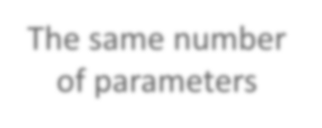



















Fat + Short v.s. Thin + Tall
The same number of parameters
Which is better?
……
x₁ x₂
……
x_{N}
x₁ x₂
x_{N}
Shallow
Deep

Slide 6



Fat + Short v.s. Thin + Tall
Layer X Size | Word Error Rate (%) | Layer X Size | Word Error Rate (%)
1 X 2k | 24.2
2 X 2k | 20.4 | W | hy?
3 X 2k | 18.4
4 X 2k | 17.8
5 X 2k | 17.2 | 1 X 3772 | 22.5
7 X 2k | 17.1 | 1 X 4634 | 22.6
 |  | 1 X 16k | 22.1
Seide, Frank, Gang Li, and Dong Yu. "Conversational Speech Transcription Using Context-Dependent Deep Neural Networks." Interspeech. 2011.

Slide 7





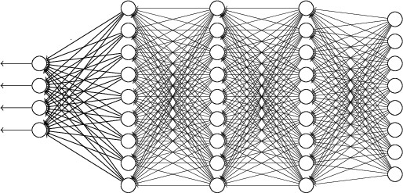
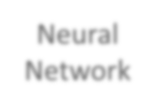


Recipe of Deep Learning
YES
Step 1: define a set of function
NO
Good Results on Testing Data?
Overfitting!
Step 2: goodness of function
YES
NO
Good Results on
Training Data?
Step 3: pick the best function
Neural
Network

Slide 8



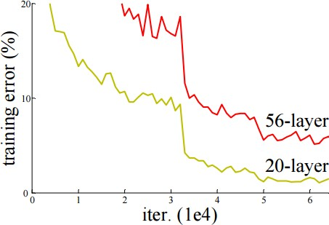
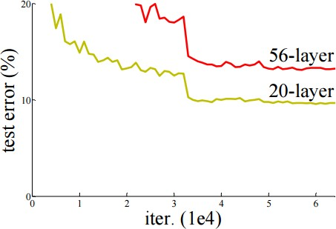





Do not always blame Overfitting
Not well trained
Overfitting?
Training Data
Testing Data

Slide 9
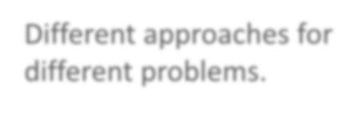



Recipe of Deep Learning
YES
Good Results on Testing Data?
Different approaches for different problems.
YES
e.g. dropout for good results on testing data
Good Results on
Training Data?
Neural
Network

Slide 10

Recipe of Deep Learning
YES
Choosing proper loss
Good Results on Testing Data?
Mini-batch
YES
New activation function
Good Results on
Training Data?
Adaptive Learning Rate
Momentum

Slide 11



















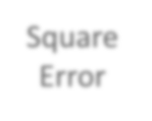
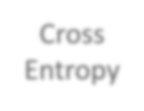




Choosing Proper Loss
“1”
x₁
……
y₁
y₂
^{y}10
1
𝑦 ₁
1
x₂
……
Softmax
0
𝑦 ₂
0
……
……
……
……
……
……
loss
^{x}256
……
𝑦 ₁₀ 0
0
Which one is better?
10
10
target
Square Error
Cross Entropy
𝑦_{𝑖} − 𝑦 _{𝑖}
2
− 𝑦 _{𝑖}𝑙𝑛𝑦_{𝑖}
𝑖=1
=0
𝑖=1
=0

Slide 12
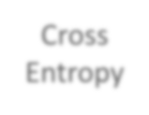


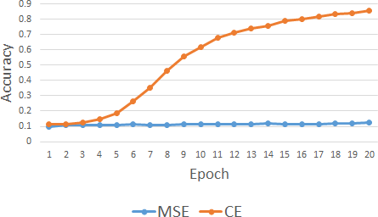
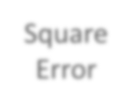


Testing:
 | Accuracy
Square Error | 0.11
Cross Entropy | 0.84
Let’s try it
Training
Cross Entropy
Square Error

Slide 13
Recipe of Deep Learning
YES
Choosing proper loss
Good Results on Testing Data?
Mini-batch
YES
New activation function
Good Results on
Training Data?
Adaptive Learning Rate
Momentum

Slide 14

























We do not really minimize total loss!
Mini-batch
Randomly initialize
network parameters
_{x}1
NN
_{y}1
Pick the 1st batch
𝐿′ = 𝑙¹ + 𝑙³¹ + ⋯
Update parameters once
Pick the 2nd batch
𝐿′′ = 𝑙² + 𝑙¹⁶ + ⋯
Update parameters once
Mini-batch
𝑦 ¹
_{𝑙}1
_{x}31
NN
_{y}31
_{𝑦} 31
_{𝑙}31
……
_{x}2
NN
_{y}2
Mini-batch
𝑦 ²
_{𝑙}2
…
Until all mini-batches have been picked
_{x}16
NN
_{y}16
_{𝑦} 16
_{𝑙}16
one epoch
……
Repeat the above process

Slide 15











Mini-batch
Pick the 1st batch
𝐿′ = 𝑙¹ + 𝑙³¹ + ⋯
Update parameters once
Pick the 2nd batch
𝐿′′ = 𝑙² + 𝑙¹⁶ + ⋯
Update parameters once
_{x}1
NN
_{y}1
𝑦 ¹
Mini-batch
_{𝑙}1
_{x}31
NN
_{y}31
_{𝑦} 31
_{𝑙}31
……
100 examples in a mini-batch
…
Until all mini-batches have been picked
Repeat 20 times
one epoch

Slide 16




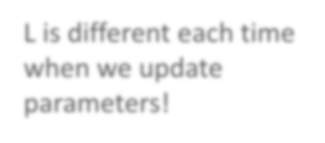


We do not really minimize total loss!
Mini-batch
Randomly initialize
network parameters
Pick the 1st batch
𝐿′ = 𝑙¹ + 𝑙³¹ + ⋯
Update parameters once
Pick the 2nd batch
𝐿′′ = 𝑙² + 𝑙¹⁶ + ⋯
Update parameters once
_{x}1
NN
_{y}1
Mini-batch
𝑦 ¹
_{𝑙}1
_{x}31
NN
_{y}31
_{𝑦} 31
_{𝑙}31
……
_{x}2
NN
_{y}2
Mini-batch
𝑦 ²
_{𝑙}2
…
L is different each time when we update parameters!
_{x}16
NN
_{y}16
_{𝑦} 16
_{𝑙}16
……

Slide 17
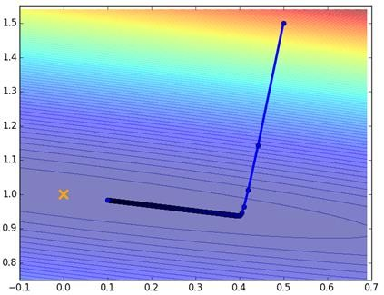
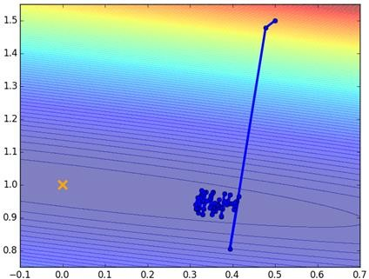




Mini-batch
Original Gradient Descent
With Mini-batch
Unstable!!!
The colors represent the total loss.

Slide 18
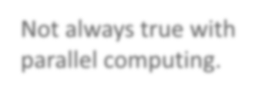


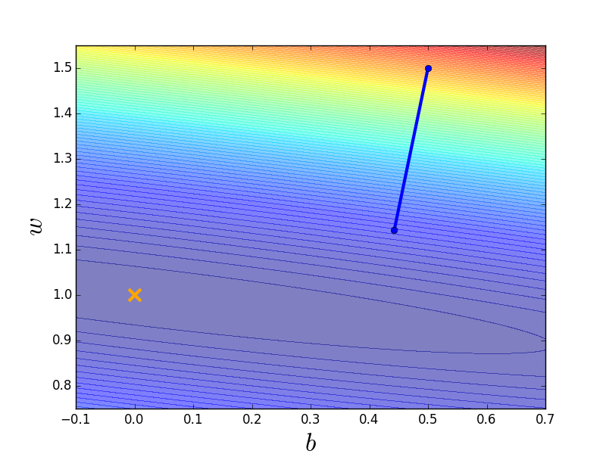
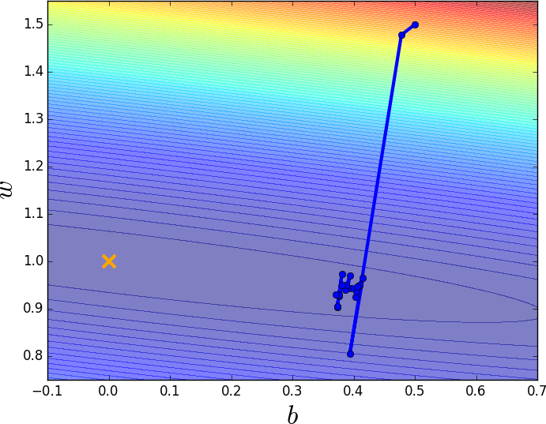
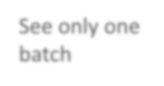

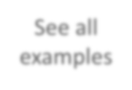












Mini-batch is Faster
Not always true with
parallel computing.
Original Gradient Descent Update after seeing all examples
With Mini-batch
If there are 20 batches, update
20 times in one epoch.
See all
See only one
examples
batch
Can have the same speed
(not super large data set)
1 epoch
Mini-batch has better performance!

Slide 19
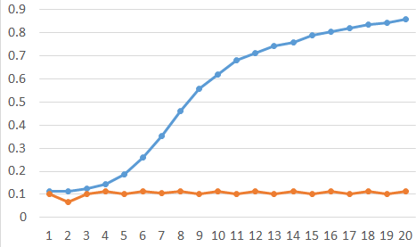






Testing:
Mini-batch is Better!
 | Accuracy
Mini-batch | 0.84
No batch | 0.12
Training
Mini-batch
No batch
Accuracy
Epoch

Slide 20
Recipe of Deep Learning
YES
Choosing proper loss
Good Results on Testing Data?
Mini-batch
YES
New activation function
Good Results on
Training Data?
Adaptive Learning Rate
Momentum

Slide 21
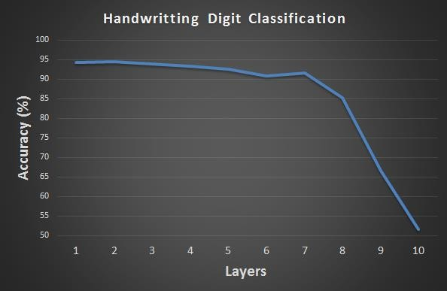

Hard to get the power of Deep …
Results on Training Data
Deeper usually does not imply better.

Slide 22
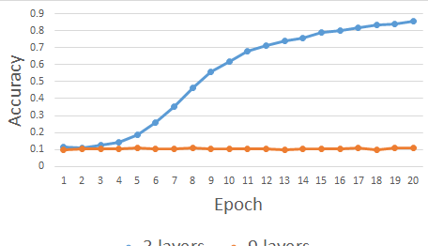





Testing:
 | Accuracy
3 layers | 0.84
9 layers | 0.11
Let’s try it
Training
3 layers
9 layers

Slide 23




















Vanishing Gradient Problem
x₁
……
y₁
x₂
……
y₂
……
……
……
……
……
x_{N}
……
y_{M}
Smaller gradients
Larger gradients
Learn very slow
Learn very fast
Almost random
Already converge
based on random!?

Slide 24


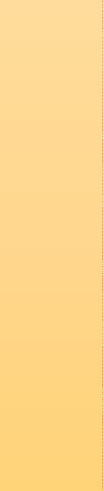
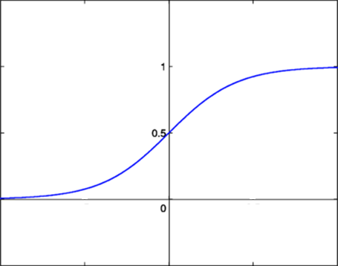





















Vanishing Gradient Problem
Smaller gradients
x₁
…
… 𝑦1 𝑦 ₁
… 𝑦2 𝑦 ₂
…… …… _{𝑙 ……}
+∆𝑙
… 𝑦𝑀 𝑦 _{𝑀}
x₂
Small output
…
……
……
……
x_{N}
…
Large input
+∆𝑤
Intuitive way to compute the derivatives …
𝜕𝑙 ∆𝑙
=?
𝜕𝑤 ∆𝑤

Slide 25
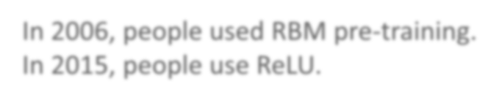


Hard to get the power of Deep …
In 2006, people used RBM pre-training. In 2015, people use ReLU.

Slide 26
ReLU
Rectified Linear Unit (ReLU)
Reason:
𝑎
Fast to compute
Biological reason
𝜎 𝑧
𝑎 = 𝑧
𝑎 = 0
3. Infinite sigmoid with different biases
𝑧
4. Vanishing gradient problem
[Xavier Glorot, AISTATS’11] [Andrew L. Maas, ICML’13] [Kaiming He, arXiv’15]

Slide 27











ReLU
𝑎
𝑎 = 𝑧
𝑎 = 0
𝑧
0
x₁
y₁
0
y₂
x
2
0
0

Slide 28








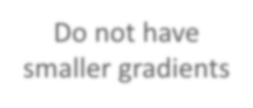
ReLU
𝑎
𝑎 = 𝑧
A Thinner linear network
𝑎 = 0
𝑧
x₁
y₁
y₂
x₂
Do not have smaller gradients

Slide 29
Let’s try it

Slide 30
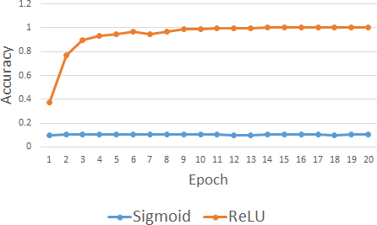





Testing:
9 layers | Accuracy
Sigmoid | 0.11
ReLU | 0.96
Let’s try it
9 layers
Training
ReLU
Sigmoid

Slide 31
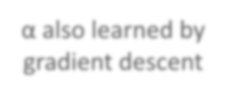


ReLU - variant
𝐿𝑒𝑎𝑘𝑦 𝑅𝑒𝐿𝑈
𝑎
𝑎 = 𝑧
𝑃𝑎𝑟𝑎𝑚𝑒𝑡𝑟𝑖𝑐 𝑅𝑒𝐿𝑈
𝑎
𝑎 = 𝑧
𝑧
𝑧
𝑎 = 0.01𝑧
𝑎 = 𝛼𝑧
α also learned by gradient descent

Slide 32
Recipe of Deep Learning
YES
Choosing proper loss
Good Results on Testing Data?
Mini-batch
YES
New activation function
Good Results on
Training Data?
Adaptive Learning Rate
Momentum

Slide 33
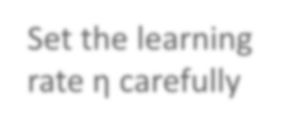


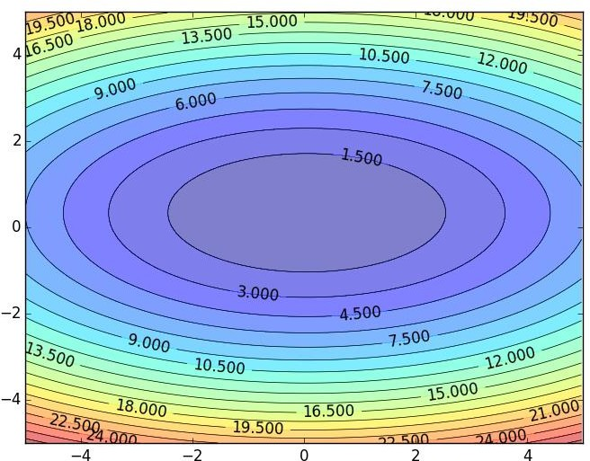




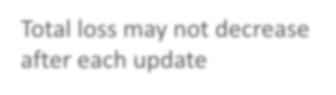



Learning Rates
Set the learning rate η carefully
If learning rate is too large
Total loss may not decrease after each update
𝑤₂
𝑤₁

Slide 34





Learning Rates
Set the learning rate η carefully
If learning rate is too large
Total loss may not decrease after each update
𝑤₂
If learning rate is too small
Training would be too slow
𝑤₁

Slide 35
Learning Rates
Popular & Simple Idea: Reduce the learning rate by some factor every few epochs.
  At the beginning, we are far from the destination, so we use larger learning rate
  After several epochs, we are close to the destination, so we reduce the learning rate
  E.g. 1/t decay: 𝜂^{𝑡} = 𝜂 𝑡 + 1
Learning rate cannot be one-size-fits-all
  Giving different parameters different learning rates

Slide 36
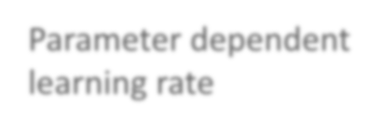





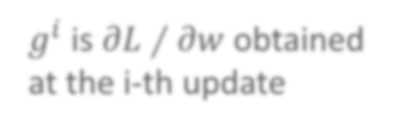



Adagrad
Original: 𝑤 ← 𝑤 − 𝜂𝜕𝐿 ∕ 𝜕𝑤
Adagrad:
w ← 𝑤 − ߟ_{𝑤}𝜕𝐿 ∕ 𝜕𝑤
Parameter dependent learning rate
𝜂
constant
ߟ_{𝑤} =
𝑡
_{𝑔}𝑖 2
𝑔^{𝑖} is 𝜕𝐿 ∕ 𝜕𝑤 obtained at the i-th update
𝑖=0
Summation of the square of the previous derivatives

Slide 37
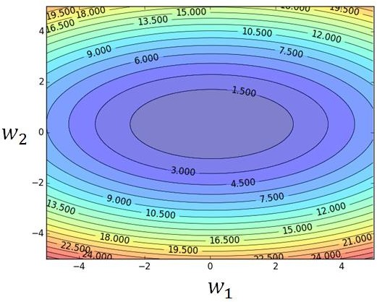
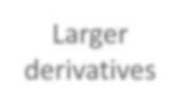


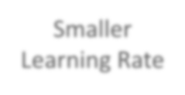







Larger
derivatives
Smaller Learning Rate
Smaller Derivatives
Larger Learning Rate
2. Smaller derivatives, larger learning rate, and vice versa
Why?

Slide 38

Not the whole story ……
Adagrad
[John Duchi, JMLR’11]
RMSprop
  https://www.youtube.com/watch?v=O3sxAc4hxZU
Adadelta [Matthew D. Zeiler, arXiv’12]
“No more pesky learning rates” [Tom Schaul, arXiv’12]
AdaSecant [Caglar Gulcehre, arXiv’14]
Adam [Diederik P. Kingma, ICLR’15]
Nadam
  http://cs229.stanford.edu/proj2015/054_report.pdf

Slide 39
Recipe of Deep Learning
YES
Choosing proper loss
Good Results on Testing Data?
Mini-batch
YES
New activation function
Good Results on
Training Data?
Adaptive Learning Rate
Momentum

Slide 40
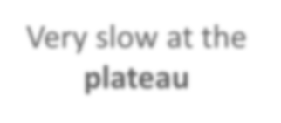















Hard to find
optimal network parameters
Total
Loss
Very slow at the
plateau
Stuck at saddle point
Stuck at local minima
𝜕𝐿 ∕ 𝜕𝑤
≈ 0
𝜕𝐿 ∕ 𝜕𝑤
= 0
𝜕𝐿 ∕ 𝜕𝑤
= 0
The value of a network parameter w

Slide 41
In physical world ……
Momentum
How about put this phenomenon in gradient descent?

Slide 42
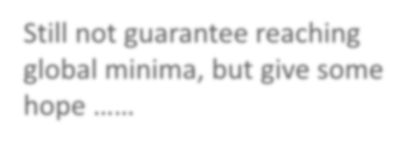





Still not guarantee reaching global minima, but give some hope ……
Momentum
cost
Movement =
Negative of 𝜕𝐿∕𝜕𝑤 + Momentum
Negative of 𝜕𝐿 ∕ 𝜕𝑤
Momentum Real Movement
𝜕𝐿∕𝜕𝑤 = 0

Slide 43

Recipe of Deep Learning
YES
Early Stopping
Good Results on Testing Data?
Weight Decay
YES
Good Results on
Training Data?
Dropout
Network Structure

Slide 44
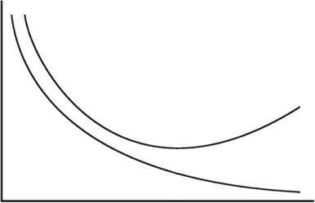



Early Stopping
Total Loss
Stop at
here
Validation set Testing set
Training set
Epochs
_{Keras:} http://keras.io/getting-started/faq/#how-can-i-interrupt-training-when- the-validation-loss-isnt-decreasing-anymore

Slide 45
Recipe of Deep Learning
YES
Early Stopping
Good Results on Testing Data?
Weight Decay
YES
Good Results on
Training Data?
Dropout
Network Structure

Slide 46
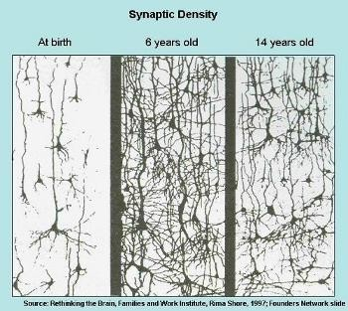
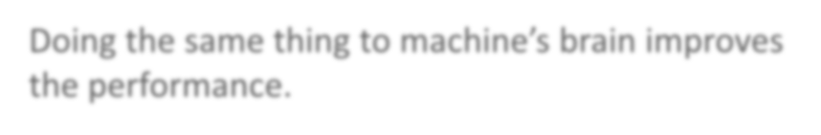


Weight Decay
Our brain prunes out the useless link between neurons.
Doing the same thing to machine’s brain improves the performance.

Slide 47
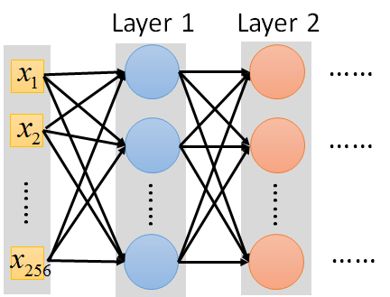
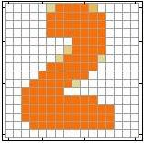






Weight Decay
Weight decay is one kind of regularization
Useless
Close to zero
(萎縮了)

Slide 48
Weight Decay
∂L
Implementation
Original:
w ← w −η
∂w
λ= 0.01
w ← ( )w −η
∂L
Weight Decay:
1−λ
∂w
Smaller and smaller
Keras: http://keras.io/regularizers/

Slide 49
Recipe of Deep Learning
YES
Early Stopping
Good Results on Testing Data?
Weight Decay
YES
Dropout
Good Results on
Training Data?
Network Structure

Slide 50



Dropout
Training:
Each time before updating the parameters
  Each neuron has p% to dropout

Slide 51

Dropout
Training:
Thinner!
Each time before updating the parameters
  Each neuron has p% to dropout
The structure of the network is changed.
  Using the new network for training
For each mini-batch, we resample the dropout neurons

Slide 52
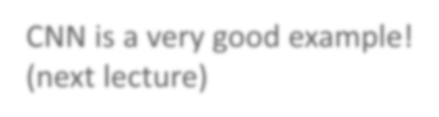


Recipe of Deep Learning
YES
Early Stopping
Good Results on Testing Data?
Regularization
YES
Good Results on
Training Data?
Dropout
Network Structure
CNN is a very good example!

Slide 53
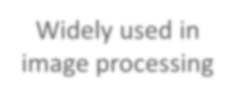


Convolutional Neural
Variants of Neural Networks
Network (CNN)
Widely used in image processing
Recurrent Neural Network (RNN)

Slide 54
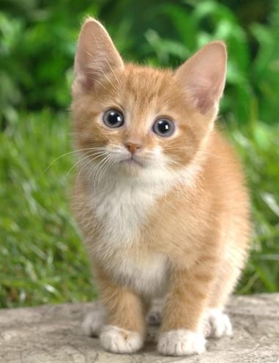










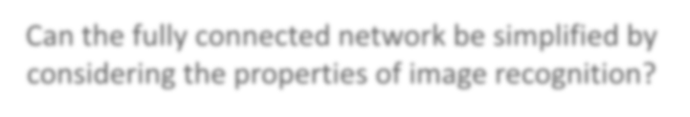


Why CNN for Image?
When processing image, the first layer of fully connected network would be very large
……
……
Softmax
100
3 x 10⁷
……
……
……
100
100 x 100 x 3
1000
Can the fully connected network be simplified by considering the properties of image recognition?

Slide 55
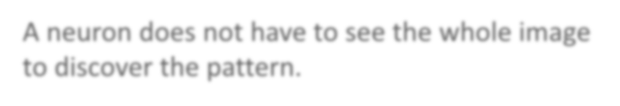



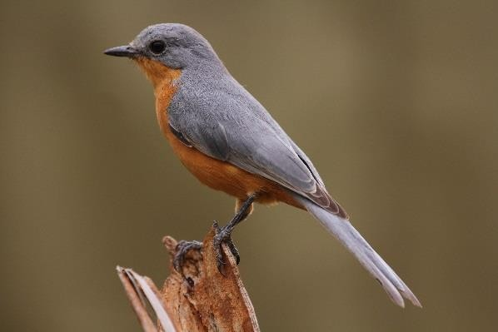

Why CNN for Image
Some patterns are much smaller than the whole image
A neuron does not have to see the whole image to discover the pattern.
Connecting to small region with less parameters
“beak” detector

Slide 56






Why CNN for Image
The same patterns appear in different regions.
“upper-left beak” detector
Do almost the same thing
They can use the same
set of parameters.
“middle beak” detector

Slide 57


Why CNN for Image
Subsampling the pixels will not change the object bird
bird
subsampling
We can subsample the pixels to make image smaller
Less parameters for the network to process the image

Slide 58
CNN – Convolution
Those are the network parameters to be learned.
1 | -1 | -1
-1 | 1 | -1
-1 | -1 | 1
1 | 0 | 0 | 0 | 0 | 1
0 | 1 | 0 | 0 | 1 | 0
0 | 0 | 1 | 1 | 0 | 0
1 | 0 | 0 | 0 | 1 | 0
0 | 1 | 0 | 0 | 1 | 0
0 | 0 | 1 | 0 | 1 | 0
Filter 1 Matrix
Filter 2 Matrix
-1 | 1 | -1
-1 | 1 | -1
-1 | 1 | -1
……
6 x 6 image
Each filter detects a small pattern (3 x 3).
Property 1

Slide 59


CNN – Convolution
1 | -1 | -1
-1 | 1 | -1
-1 | -1 | 1
Filter 1
stride=1
1 | 0 | 0 | 0 | 0 | 1
0 | 1 | 0 | 0 | 1 | 0
0 | 0 | 1 | 1 | 0 | 0
1 | 0 | 0 | 0 | 1 | 0
0 | 1 | 0 | 0 | 1 | 0
0 | 0 | 1 | 0 | 1 | 0
3
-1
6 x 6 image

Slide 60
CNN – Convolution
1 | -1 | -1
-1 | 1 | -1
-1 | -1 | 1
Filter 1
If stride=2
1 | 0 | 0 | 0 | 0 | 1
0 | 1 | 0 | 0 | 1 | 0
0 | 0 | 1 | 1 | 0 | 0
1 | 0 | 0 | 0 | 1 | 0
0 | 1 | 0 | 0 | 1 | 0
0 | 0 | 1 | 0 | 1 | 0
3
-3
We set stride=1 below
6 x 6 image

Slide 61














CNN – Convolution
-1 | 1 | -1
-1 | 1 | -1
-1 | 1 | -1
Filter 2
stride=1
Do the same process for every filter
1 | 0 | 0 | 0 | 0 | 1
0 | 1 | 0 | 0 | 1 | 0
0 | 0 | 1 | 1 | 0 | 0
1 | 0 | 0 | 0 | 1 | 0
0 | 1 | 0 | 0 | 1 | 0
0 | 0 | 1 | 0 | 1 | 0
3 -1 | -1 -1 | -3 -1 | -1 -
-3 | 1 | 0 | -3
1
-
1 -1 -2
-3 0
1
Feature Map
-1 -2
-3
1
-1
1
6 x 6 image
3
-2 -2
0 -4
4 x 4 image
-1
-1
3

Slide 62
CNN – Zero Padding
1 | -1 | -1
-1 | 1 | -1
-1 | -1 | 1
Filter 1
0 0 0
0 0 | 1 | 0 | 0 | 0 | 0 | 1
 | 0 | 1 | 0 | 0 | 1 | 0
 | 0 | 0 | 1 | 1 | 0 | 0
 | 1 | 0 | 0 | 0 | 1 | 0
 | 0 | 1 | 0 | 0 | 1 | 0 | 0 0
 | 0 | 0 | 1 | 0 | 1 | 0
 |  |  |  |  | 0 0 0
You will get another 6 x 6 images in this way
Zero padding
6 x 6 image

Slide 63

CNN – Colorful image
1
-1
-1
-1
-1
1
1
-1
-1
1
-1
-1
-1 1 -1
1 -1 -1
-1
1
-1
-1
-1
1
1
-1
-1
-1
1
-1
-1 1 -1
Filter 2
-1 1 -1 Filter 1
-1
-1
1
-1
-1
1
1
-1
-1
-1
-1
1
-1 1 -1
-1 -1 1
Colorful image
 |  | 1 | 0 | 0 | 0 | 0 | 1
 |  | 0 | 1 | 0 | 0 | 1 | 0
 |  | 0 | 0 | 1 | 1 | 0 | 0
 |  | 1 | 0 | 0 | 0 | 1 | 0
 |  | 0 | 1 | 0 | 0 | 1 | 0
 |  | 0 | 0 | 1 | 0 | 1 | 0
1
0
0
0
0
1
1
0
0
0
0
1
0
1
0
0
1
0
0
1
0
0
1
0
0
0
1
1
0
0
0
0
1
1
0
0
1
0
0
0
1
0
1
0
0
0
1
0
0
1
0
0
1
0
0
1
0
0
1
0
0
0
1
0
1
0
0
0
1
0
1
0

Slide 64
















CNN – Max Pooling
1 | -1 | -1
-1 | 1 | -1
-1 | -1 | 1
-1 | 1 | -1
-1 | 1 | -1
-1 | 1 | -1
Filter 1
Filter 2
3 | -1 |  | -3 | -1
-3 | 1 |  | 0 | -3
-3 | -3 |  | 0 | 1
3 | -2 |  | -2 | -1
-1 | -1 |  | -1 | -1
-1 | -1 |  | -2 | 1
-1 | -1 |  | -2 | 1
-1 | 0 |  | -4 | 3

Slide 65






CNN – Max Pooling
New image but smaller
3 0
-1 1
3 ₀ 1 ₃
2 x 2 image
Each filter is a channel
1 | 0 | 0 | 0 | 0 | 1
0 | 1 | 0 | 0 | 1 | 0
0 | 0 | 1 | 1 | 0 | 0
1 | 0 | 0 | 0 | 1 | 0
0 | 1 | 0 | 0 | 1 | 0
0 | 0 | 1 | 0 | 1 | 0
Conv
Max Pooling
6 x 6 image

Slide 66





















The whole CNN
0 ₁
3 ₀ 1 ₃
3
-1
Convolution
Max Pooling
Can repeat
many times
A new image
Smaller than the original image
The number of the channel is the number of filters
Convolution
Max Pooling

Slide 67







The whole CNN
cat dog ……
Convolution
Max Pooling
Can repeat
many times
Fully Connected Feedforward network
Convolution
Max Pooling
Flatten

Slide 68




































Flatten
3
0
1
3
-1
0
1
3
3 ₀ 1 ₃
-1
Flatten
1
Fully Connected Feedforward network
0
3

Slide 69



Variants of Neural Networks
Convolutional Neural Network (CNN)
Recurrent Neural Network (RNN)
Neural Network with Memory

Slide 70

Example Application
Slot Filling
I would like to arrive Taipei on November 2nd.
ticket booking system
Destination: time of arrival:
Taipei November 2nd
Slot

Slide 71








Recurrent Neural Network (RNN)
y₁ y₂
The output of hidden layer are stored in the memory.
store
a₁ a₂
Memory can be considered as another input.
x₁
x₂

Slide 72












RNN
The same network is used again and again.
Probability of
“arrive” in each slot
Probability of “Taipei” in each slot
Probability of “on” in each slot
_{y}1
_{y}2
_{y}3
_{a}1
store
store
_{a}2
_{a}3
_{a}1
_{a}2
_{x}1
_{x}2
_{x}3
arrive
Taipei
on November
₂nd

Slide 73


















RNN
Different
Prob of “leave” in each slot
Prob of “Taipei” in each slot
Prob of “arrive” in each slot
Prob of “Taipei” in each slot
_{y}1
_{y}2
……
_{y}1
_{y}2
……
_{a}1
store
_{a}2
_{a}1
store
_{a}2
_{a}1
……
_{a}1
……
_{x}1
_{x}2
……
_{x}1
_{x}2
……
leave
Taipei
arrive
Taipei
The values stored in the memory is different.

Slide 74





























Of course it can be deep …
_{y}t _{y}t+1 _{y}t+2
……
……
……
……
……
……
……
……
……
_{x}t
_{x}t+1
_{x}t+2

Slide 75


























Bidirectional RNN
_{x}t
_{x}t+1
_{x}t+2
……
……
_{y}t
_{y}t+1
_{y}t+2
……
……
_{x}t
_{x}t+1
_{x}t+2

Slide 76




Long Short-term Memory (LSTM)
Other part of the network
Special Neuron: 4 inputs,
1 output
Signal control
the output gate
(Other part of
the network)
Output Gate
Memory Cell
Forget
Gate
Signal control
the forget gate
(Other part of the network)
Signal control the input gate (Other part of the network)
LSTM
Input Gate
Other part of the network

Slide 77



𝑎 = ℎ 𝑐′
𝑓 𝑧_{𝑜}
𝑧_{𝑜}
multiply
Activation function f is usually a sigmoid function
Between 0 and 1
Mimic open and close gate
𝑓 𝑧_{𝑜}
ℎ 𝑐′
𝑐 𝑓 𝑧_{𝑓}
𝑐c′
𝑧_{𝑓}
𝑐𝑓 𝑧_{𝑓}
𝑔 𝑧 𝑓 𝑧_{𝑖}
multiply
𝑔 𝑧
𝑐′ = 𝑔 𝑧 𝑓 𝑧_{𝑖}
+ 𝑐𝑓 𝑧_{𝑓}
𝑓 𝑧_{𝑖}
𝑧
𝑖
𝑧

Slide 78
Next Wave

Slide 79
Outline
Supervised Learning
Ultra Deep Network
Attention Model
Reinforcement Learning
New network structure
Unsupervised Learning
Image: Realizing what the World Looks Like
Text: Understanding the Meaning of Words
Audio: Learning human language without supervision

Slide 80

Skyscraper
https://zh.wikipedia.org/wiki/%E9%9B%99%E5%B3%B0%E5%A1%94#/me
dia/File:BurjDubaiHeight.svg

Slide 81












Ultra Deep Network
22 layers
http://cs231n.stanford.e du/slides/winter1516_le cture8.pdf
19 layers
8 layers
6.7%
7.3%
16.4%
AlexNet (2012)
VGG (2014)
GoogleNet (2014)

Slide 82



Ultra Deep Network
152 layers
3.57%
7.3%
6.7%
16.4%
AlexNet
(2012)
VGG
(2014)
GoogleNet (2014)
Residual Net (2015)

Slide 83

Ultra Deep Network
Worry about overfitting?
152 layers
Worry about training first!
This ultra deep network have special structure.
3.57%
7.3%
6.7%
16.4%
AlexNet
(2012)
VGG
(2014)
GoogleNet (2014)
Residual Net
(2015)

Slide 84









Ultra Deep Network
• •
+
copy
Gate controller
copy

Slide 85
























output layer
output layer
output layer
Highway Network automatically determines the layers needed!
Input layer
Input layer
Input layer

Slide 86
Outline
Supervised Learning
Ultra Deep Network
New network structure
Attention Model
Reinforcement Learning
Unsupervised Learning
Image: Realizing what the World Looks Like
Text: Understanding the Meaning of Words
Audio: Learning human language without supervision

