Slide 1
CSSE 490 Deep Reinforcement Learning
Model Free Prediction and Control
Slides are heavily adapted the slides from IERG 5350

Slide 2
Outline
Model-free prediction: Estimate value function of an unknown MDP
Model-free control: Find a policy that maximize value function under an unknown MDP

Slide 3
Model-free prediction Overview
Both of the policy iteration and value iteration assume the direct access to the dynamics and rewards of the environment
The problem of model-free prediction:
In a lot of real-world problems, MDP model is either unknown or known by too big or too complex to use
Atari Game, Game of Go, Helicopter, Portfolio management, etc

Slide 4
Model-free prediction: policy evaluation without the access to the model
Estimating the expected return of a particular policy if we don't have access to the MDP models
Monte Carlo policy evaluation
Temporal Difference (TD) learning

Slide 5
Monte-Carlo Policy Evaluation
MC simulation: we can simply sample a lot of trajectories, compute the actual returns for all the trajectories, then average them
MC policy evaluation uses empirical mean return instead of expected return
Only applied to episodic MDPs (each episode terminates)

Slide 6
Monte-Carlo Policy Evaluation

Slide 7
Incremental MC Updates

Slide 8
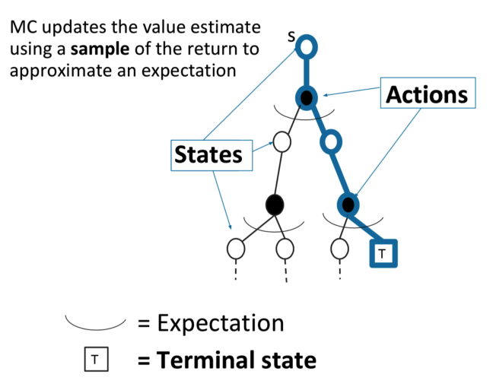
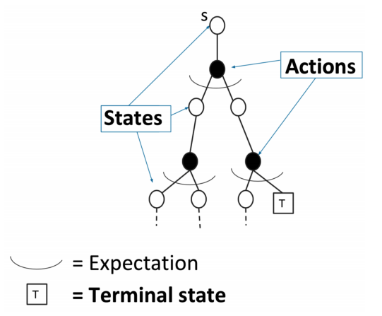
Difference between DP and MC for policy evaluation
DP MC

Slide 9
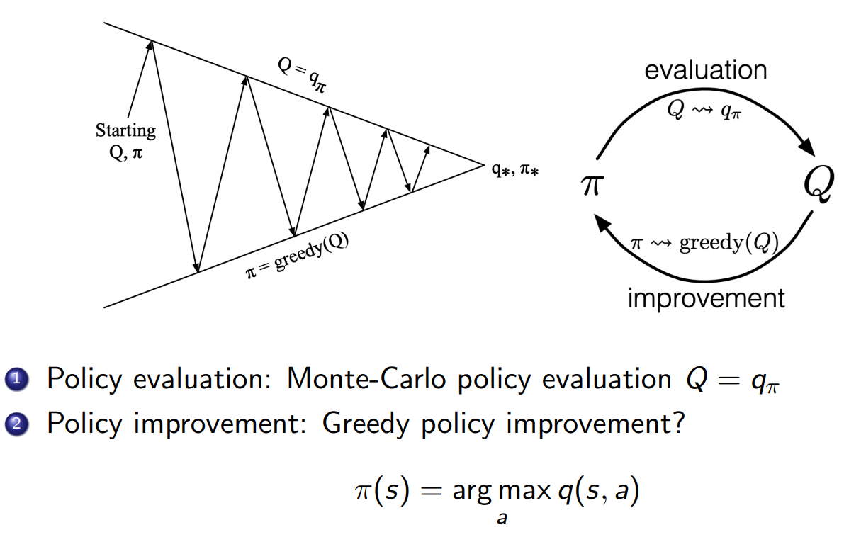
Model-free control with MC
Generalized Policy Iteration with Action-Value Function

Slide 10
Monte Carlo with ε-Greedy Exploration
Trade-off between exploration and exploitation (we will talk about this in a later lecture)
ε-Greedy Exploration

Slide 11
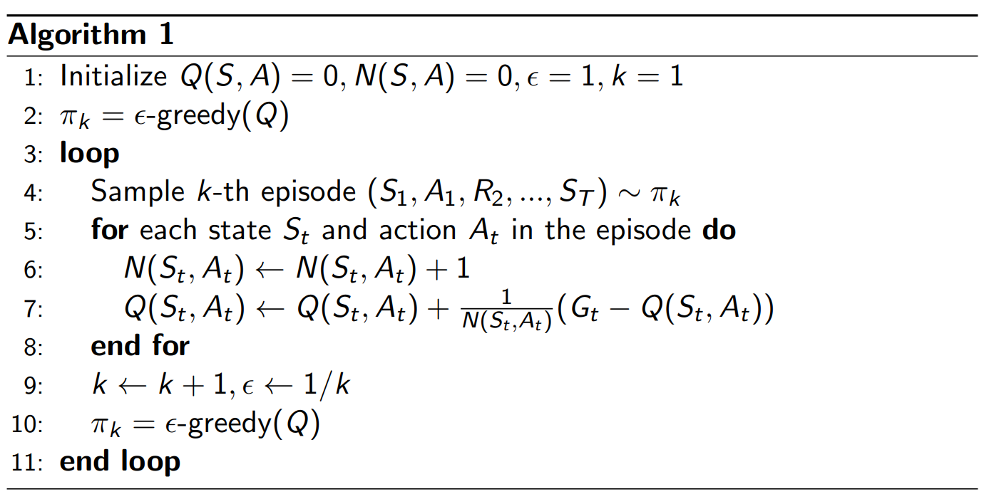
Monte Carlo with ε-Greedy Exploration

Slide 12
MC Demo

Slide 13
Temporal-Difference (TD) Learning
TD learns from incomplete episodes, by bootstrapping
Bootstrapping: Assuming we have one or more estimated values, even though the assuming value could be garbage at the beginning.
Simplest TD algorithm: TD(0)
TD target
TD Error

Slide 14
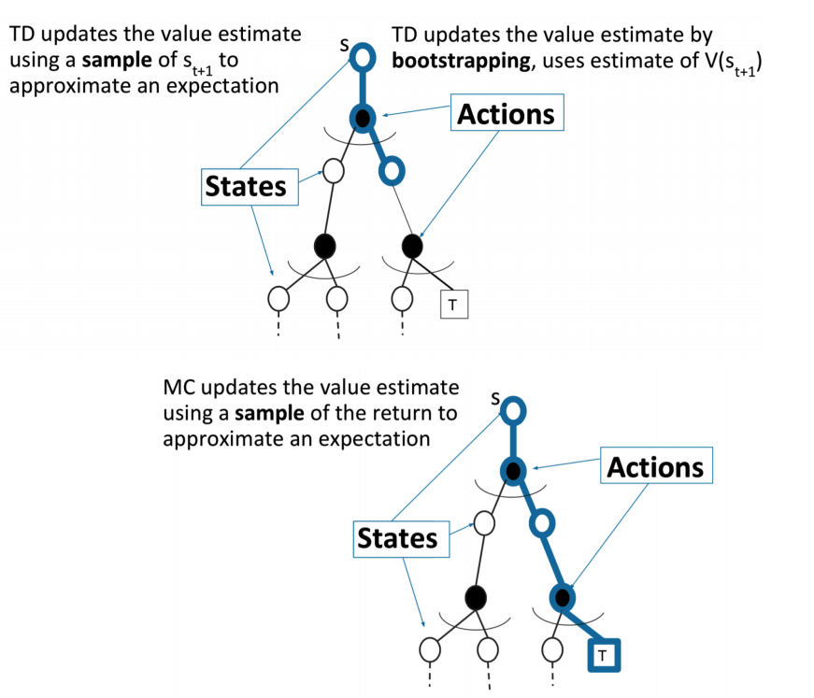
Advantages of TD over MC

Slide 15
Comparison of TD and MC
TD can learn online after every step
MC must wait until end of episode before return is known
TD can learn from incomplete sequences
MC can only learn from complete sequences
TD works in continuing (non-terminating) environments
MC only works for episodic (terminating) environments
TD exploits Markov property, more efficient in Markov environments
MC does not exploit Markov property, more effective in non-Markov environments

Slide 16
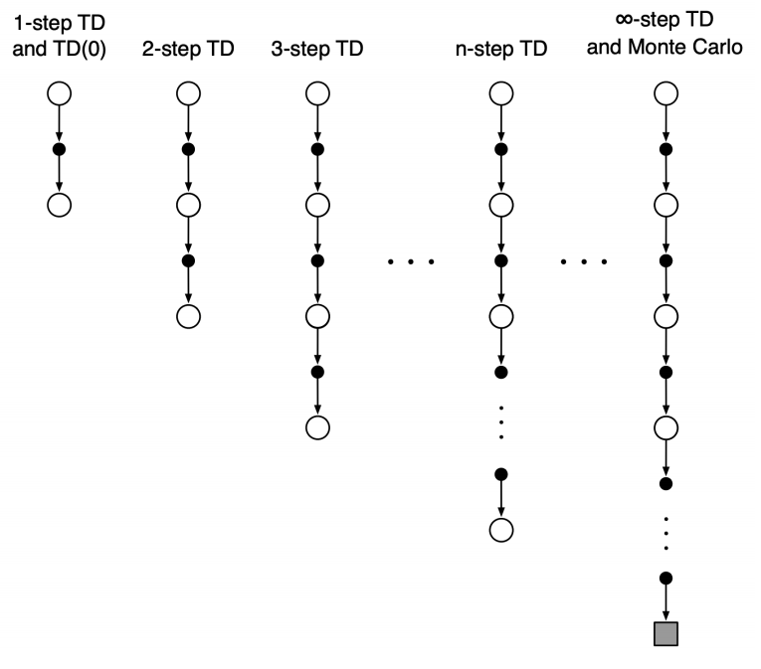
n-step TD
n-step TD methods that generalize both one-step TD and MC
We can shift from one to the other smoothly as needed to meet the demands of a particular task.

Slide 17
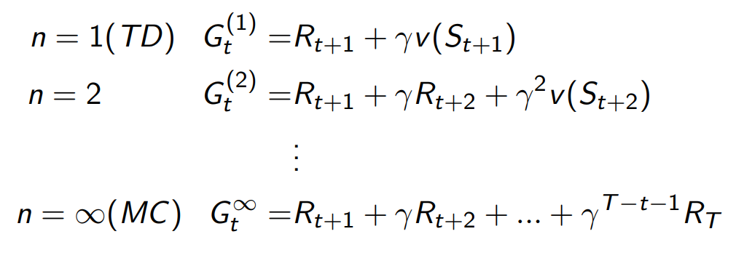
n-step TD prediction
Consider the following n-step returns for n = 1, 2, ∞
n-step TD:
Pros and Cons of N-Step?

Slide 18
Sarsa: On-Policy TD Control
ε-greedy policy for one step, then bootstrap the action value function:

Slide 19
Sarsa algorithm

Slide 20
More
In the lab, you will implement Sarsa
More materials to learn for this lecture:
Lecture of David Silver video
Next, we will introduce deep learning to better represent the value functions, instead of tables we’ve used so far.

