Slide 1
CSSE 490 Deep Reinforcement Learning
An appetizer- Cross Entropy Method
Slides are partially adapted from IERG 5350 @ CUHK

Slide 2
Outline
RL components
CEM as a RL solution

Slide 3
Agent and Environment
The agent learns to interact with the environment
Agent
Environment
Action
Consequence: Observation Reward

Slide 4
Major Components of an RL Agent
An RL agent may include one or more of these components:
Policy: agent’s behavior function
Value function: how good is each state or action (will introduce later)
Model: agent’s state representation of the environment (will introduce later)

Slide 5
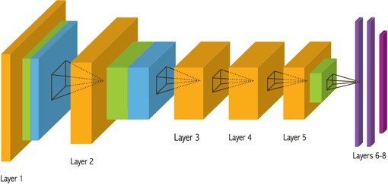
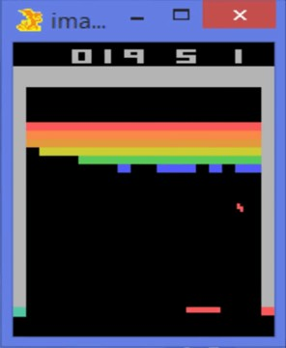
Policy
A policy is the agent’s behavior model
It is a map function from state/observation to action.
Stochastic policy: Probabilistic sample
Deterministic policy:
Action:
Move LEFT or RIGHT

Slide 6
Cross-Entropy Method
It is an optimization method:
A black-box approach to fit model parameters for data.
it is an Evolutionary Algorithm.
Let me give you an example of using CEM for curve-fitting.

Slide 7
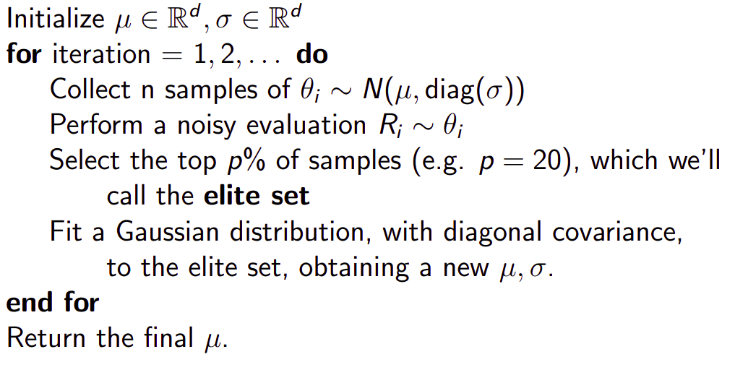
CEM pseudo code

